Slide 1
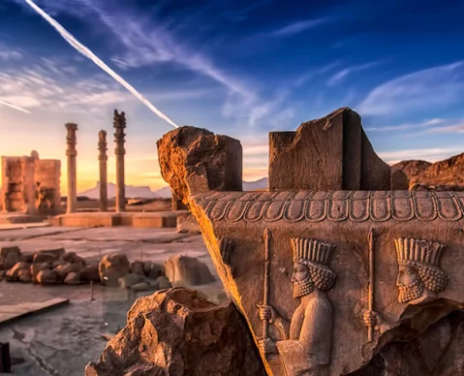
The Persians

Slide 2
Who were the Persians?
The Persians were an Indo-European-speaking people related to the Medes.
The Persians lived to the southeast of the Medes, who occupied the western Iranian plateau south of the Caspian Sea.
Although crops were grown, lack of moisture made the lands of these peoples more suitable for pasture.
The Medes, in particular, were famous throughout the Near East for the quality of the horses they bred.
Primarily nomadic, both Medes and Persians were organized in clans. Both peoples were led by petty kings assisted by a group of warriors who formed a class of nobles.
Their populations also included both free and unfree people who worked the land, craftspeople, and slaves.

Slide 3
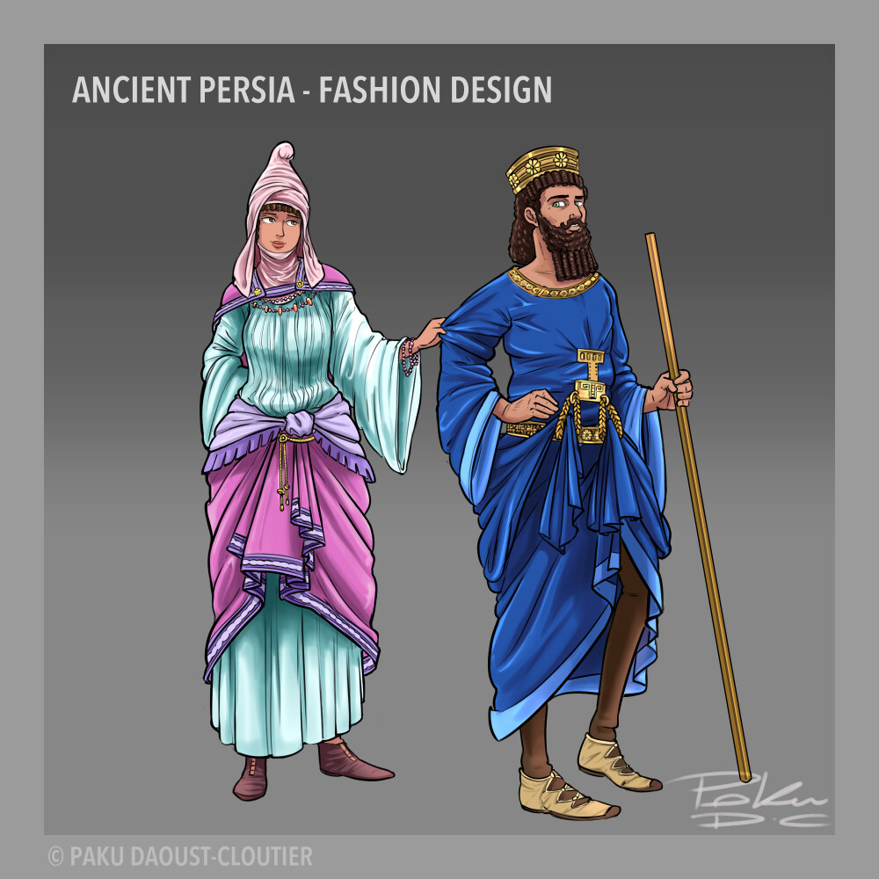
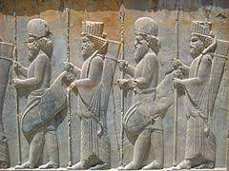
Persians

Slide 4
Medes and Persians
By 735 B.C., the Medes had begun to form a confederation of the various tribes, and sometime around the beginning of the seventh century, they became unified under a monarchy.
The Persians did likewise under the Achaemenid dynasty established in Persis in southern Iran.
About fifty years later, the Persians were made subject to the Medes.
The Medes now constituted a powerful state and joined the Babylonians in attacking the Assyrians.
After the capture of Nineveh in 612 B.C., King Cyaxares established a Median empire, the first Iranian empire known to the ancient Near East.

Slide 5
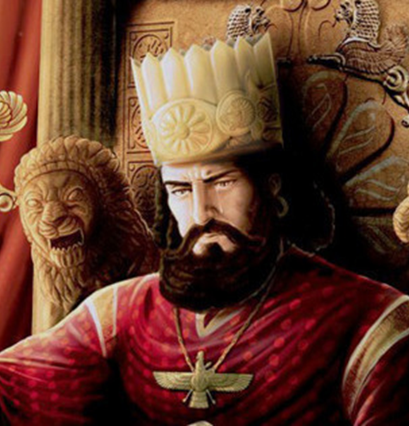
Cyrus the Great
In 559 B.C., Cyrus became the leader of the Persians, united them under his rule, and went on the offensive against the Medes.
In 550 B.C. he established Persian control over Media, making it the first Persian satrapy (province).
Three years later, Cyrus defeated the prosperous Lydian kingdom in western Asia Minor, and Lydia became another Persian satrapy
Cyrus’ forces then went on to conquer the Greek city-states that had been established on the Ionian coast of western Asia Minor.
Cyrus then turned eastward, subduing the eastern part of the Iranian plateau, Sogdia, and even western India.
His eastern frontiers secured, Cyrus entered Mesopotamia in 539 and captured Babylon.
  His treatment of Babylonia showed remarkable restraint and wisdom. Babylonia was made into a Persian province under a Persian satrap, or governor, but many government officials were kept in their positions.

Slide 6
What did Cyrus the Great call himself (other than the Great)?
‘‘King of All, Great King, Mighty King, King of Babylon, King of the Land of Sumer and Akkad, King of the Four Rims (of the Earth), the Son of Cambyses the Great King, King of Anshan’’

Slide 7
What did others think of him?
The Greek historian Herodotus recounted that the Persians viewed him as a ‘‘father,’’ a ruler who was ‘‘gentle, and procured them all manner of goods.’’
Cyrus must have been an unusual ruler for his time, a man who demonstrated considerable wisdom and compassion in the conquest and organization of his empire.
Cyrus obtained the favor of the priesthoods in his conquered lands by restoring temples and permitting religious toleration.
He won approval by using not only Persians but also native peoples as government officials in their own states.
  He allowed Medes to be military commanders.
Unlike the Assyrian rulers of an earlier empire, he had a reputation for mercy.
Medes, Babylonians, and Jews all accepted him as their legitimate ruler.
Some peoples portrayed him as a great leader and peacemaker.

Slide 8
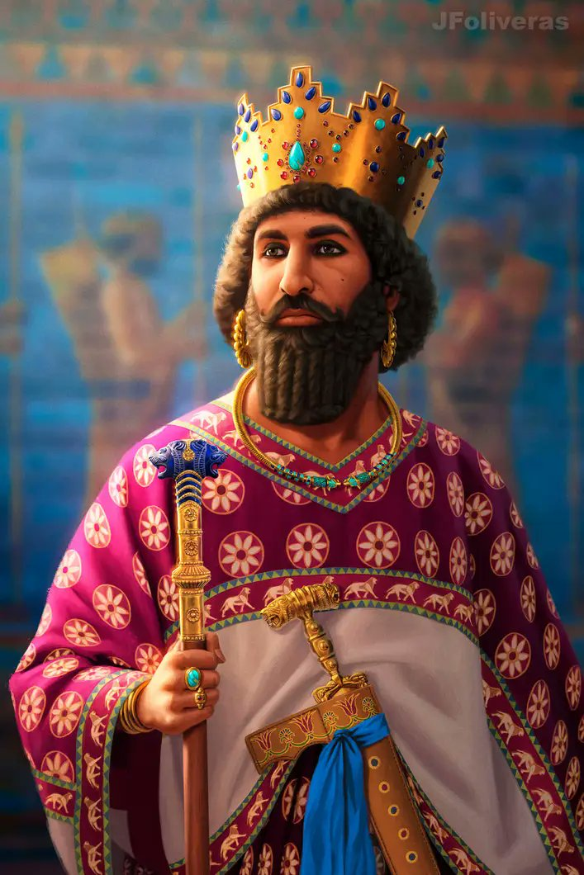
Cambyses
Upon Cyrus’ death in 530 B.C., his son Cambyses II assumed power as the Great King.
Four years later, Cambyses undertook the invasion of Egypt, the only kingdom in the Near East not yet brought under Persian control.
Aided by the Phoenician fleet, he defeated and captured the pharaoh and the Egyptian forces.
Egypt was made into a satrapy with Memphis as its capital.
Cambyses took the title of pharaoh.

Slide 9
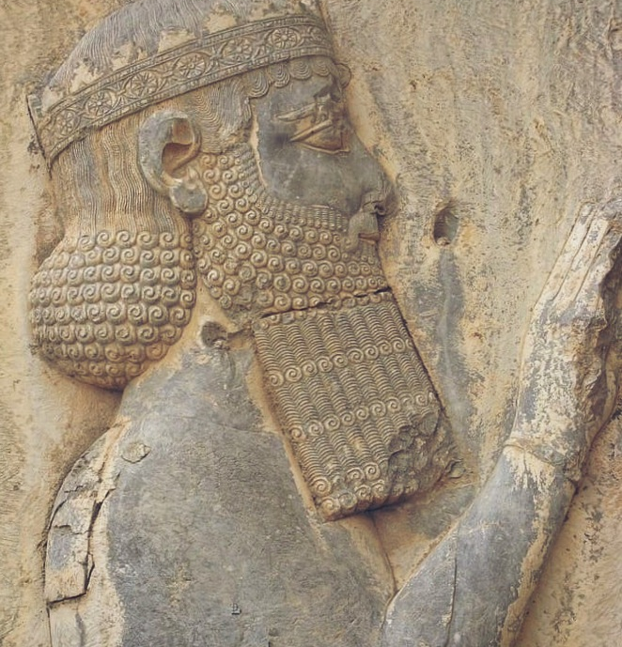
Darius
After the death of Cambyses in 522, Darius emerged as Great King after a year of intense civil war.
Once in charge, Darius (521--486 B.C.) turned to the task of strengthening the empire.
He codified Egyptian law and built a canal to link the Red Sea and the Mediterranean.
A campaign into western India led to the creation of a new Persian province that extended to the Indus River.
Darius also moved into Europe proper, conquering Thrace and making the Macedonian king a vassal

Slide 10
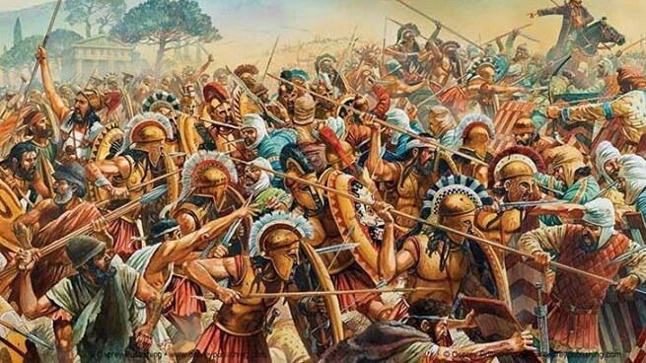
Meet the Greeks
A revolt of the Ionian Greek cities in 499 B.C. resulted in temporary freedom for these communities in western Asia Minor.
Aid from the Greek mainland, most notably from Athens, led to a brief invasion of Lydia by the Ionians and the burning of Sardis, center of the Lydian satrapy.
This event led to Darius’ involvement with the mainland Greeks.
After reestablishing control of the Ionian Greek cities, Darius undertook an invasion of the Greek mainland, which culminated in the Athenian victory in the Battle of Marathon in 490 B.C.

Slide 11
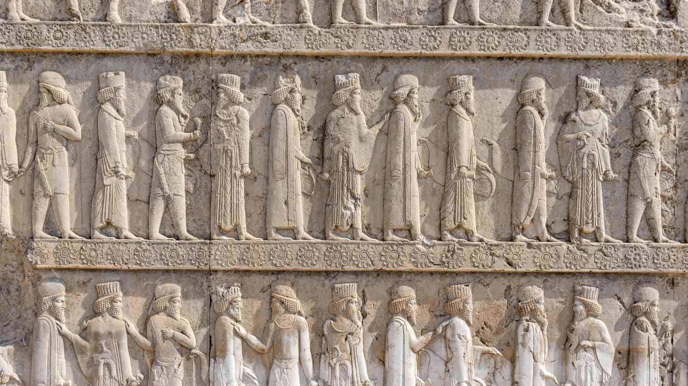
Governing the Empire
The Persians had created the largest empire the world had yet seen.
  It not only included all the old centers of power in the Near East, Egypt, Mesopotamia, and Assyria but also extended into Thrace and Asia Minor in the west and into India in the east.
For administrative purposes, the empire had been divided into satrapies.
  Each province was ruled by a governor or satrap, literally a ‘‘protector of the kingdom.’’
Satraps
  collected tributes,
  were responsible for justice and security,
  raised military levies, and normally commanded the military forces within their satrapies.
Satraps were miniature kings who established courts imitative of the Great King’s.
There were officials who reported directly to the Great King, keeping him informed of what was going on within the various satrapal governments.
It is also possible that an official known as the ‘‘king’s eye’’ or ‘‘king’s messenger’’ made annual inspections of each satrapy.

Slide 12
Keeping the Empire running
An efficient system of communication was considered crucial to sustaining the Persian Empire.
Well maintained roads facilitated the rapid transit of military and government personnel.
The Royal Road stretched from Sardis, the center of Lydia in Asia Minor, to Susa, the chief capital of the Persian Empire.
But Susa was oppressively hot in the summer months.
So, Darius built Persepolis, a new capital located to the east of the old one and at a higher elevation
Like the Assyrians, the Persians established staging posts equipped with fresh horses for the king’s messengers.

Slide 13
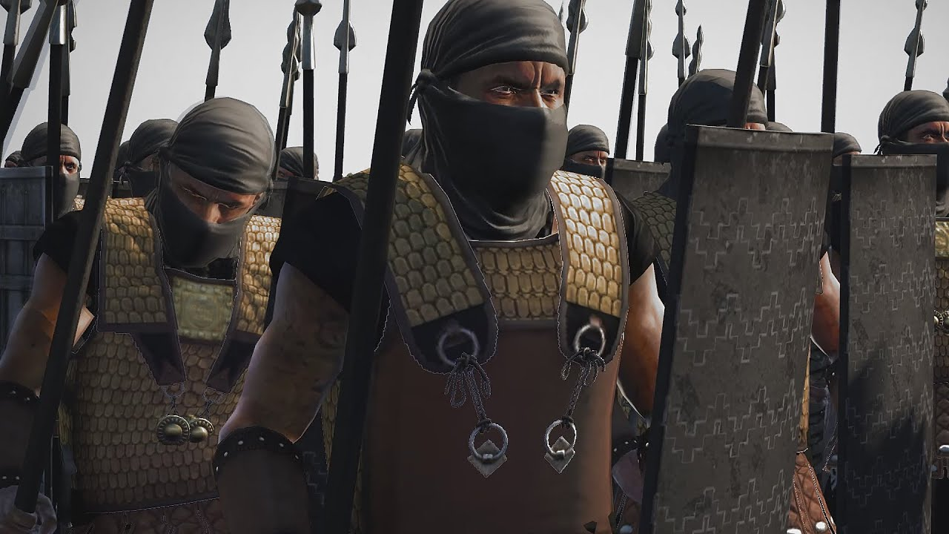
Military
In its heyday, however, the empire stood supreme, and much of its power depended on the military.
By the time of Darius, the Persian monarchs had created a standing army of international, professional soldiers.
This army was truly international, composed of contingents from the various peoples who made up the empire.
At its core was a cavalry force of ten thousand and an elite infantry, the Immortals, and included great archers.

Slide 14
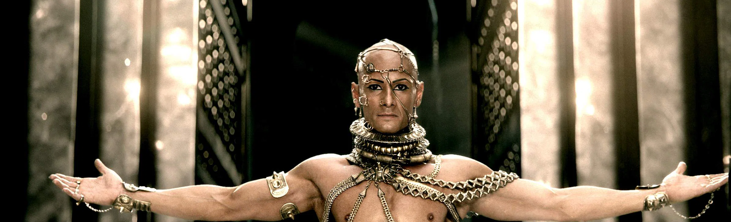
The cracks begin…
Over a period of time, the Great Kings in their greed came to hoard immense quantities of gold and silver in the various treasuries located in the capital cities.
Both their hoarding of wealth and their later over-taxation of their subjects are seen as crucial factors in the ultimate weakening of the Persian Empire.

Slide 15
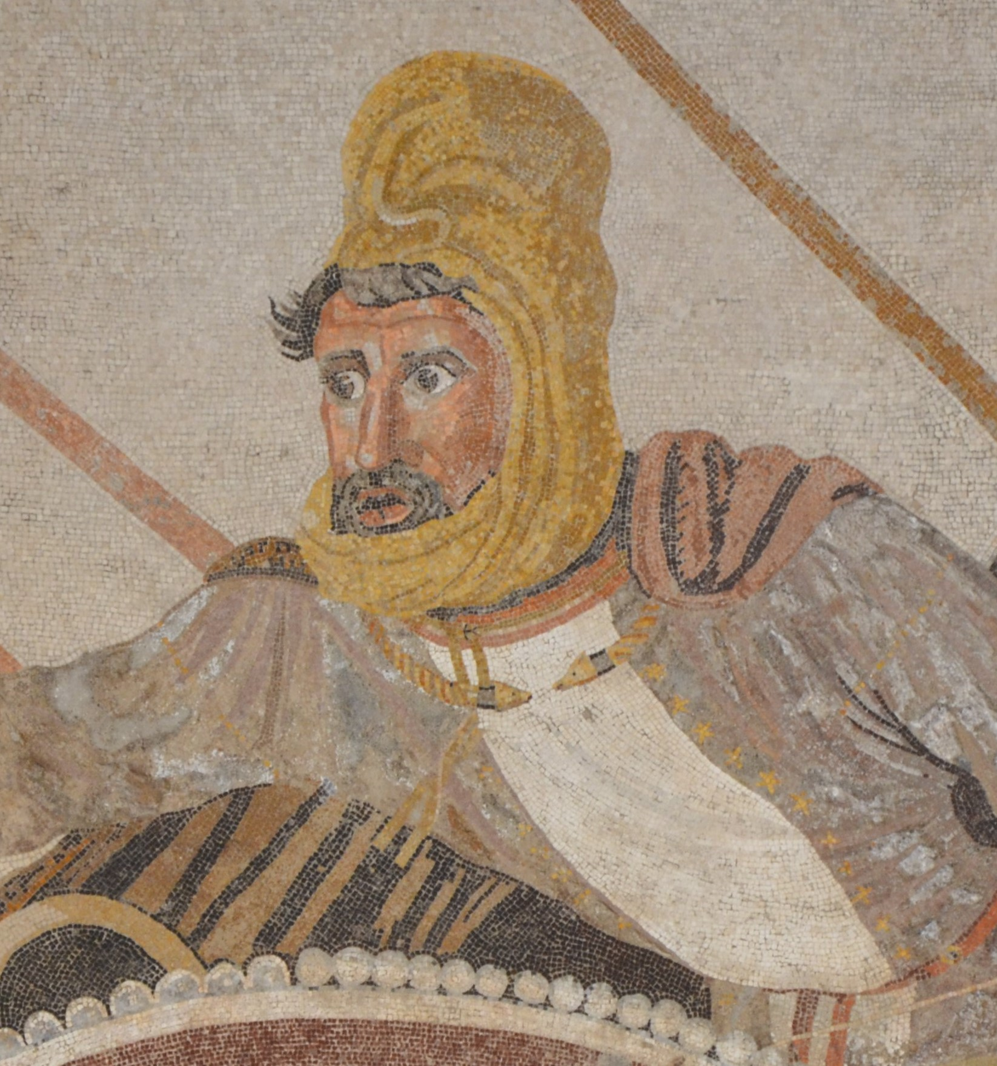
The Great King
Exalted position
All subjects of the Empire were his servants, and he possessed the power of life and death over all
Due partly to his wars against the Greeks, the Great King Xerxes has to raise taxes, leading to rebellion in the empire.

Slide 16
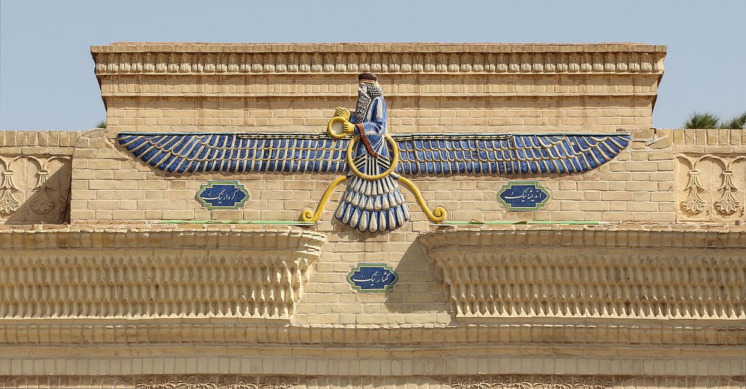
Persian religion: Zoroastrianism
Before Zoroastrianism, the popular religion of the Iranians was worship of the forces of nature
Zoroaster (or Zarathustra) was a semilegendary figure who wandered in solitude and experienced revelations
He was seen as a prophet
He taught that Ahuramazda was the only god and his worship was the only true religion

Slide 17
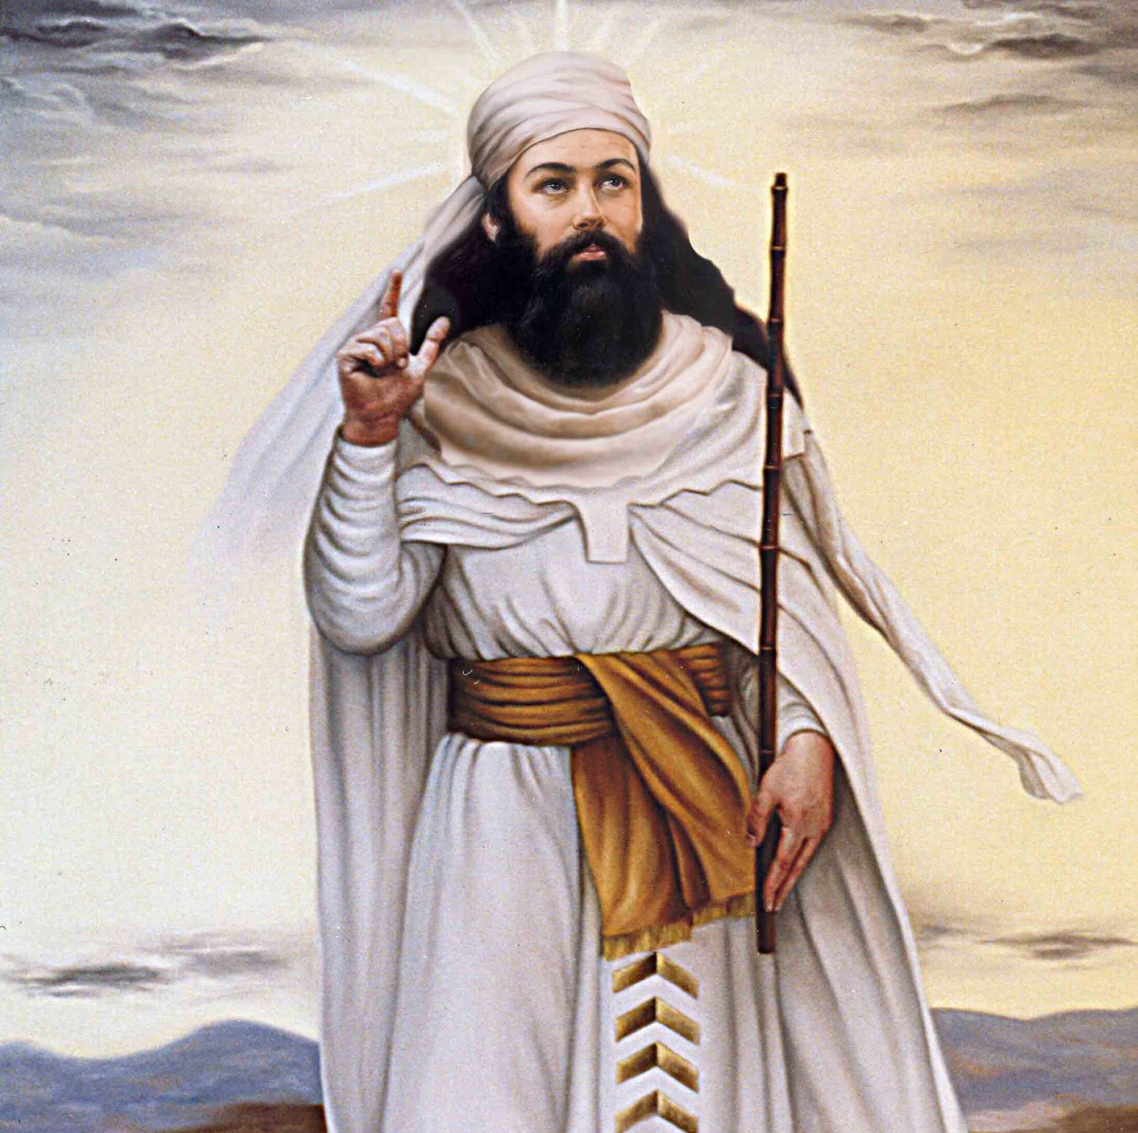
Zoroastrianism
Constant struggle between good and evil
Humans played a role since Ahuramazda gave humans free will.
Each souls faced a final evaluation of its actions
A person who performed good deeds would go to paradise and the one who performed bad deeds would be thrown in the abyss.
The spread of this religion was because the Persian kings accepted it, although they did not make it mandatory.
The tenets of Zoroastrianism might have influenced Christianity

